Slide 1

FLEET MANAGEMENT SYSTEM FOR LOGISTICS
BY :
K.BALAGUHAN V.YOGESHWARAN

Slide 2




Introduction to Fleet Management
is transforming the logistics industry by enhancing and
.
Purpose: The goal of a Fleet Management System (FMS) is to improve efﬁciency, reduce costs, and maintain real-time tracking of vehicles, drivers, and cargo..

Slide 3
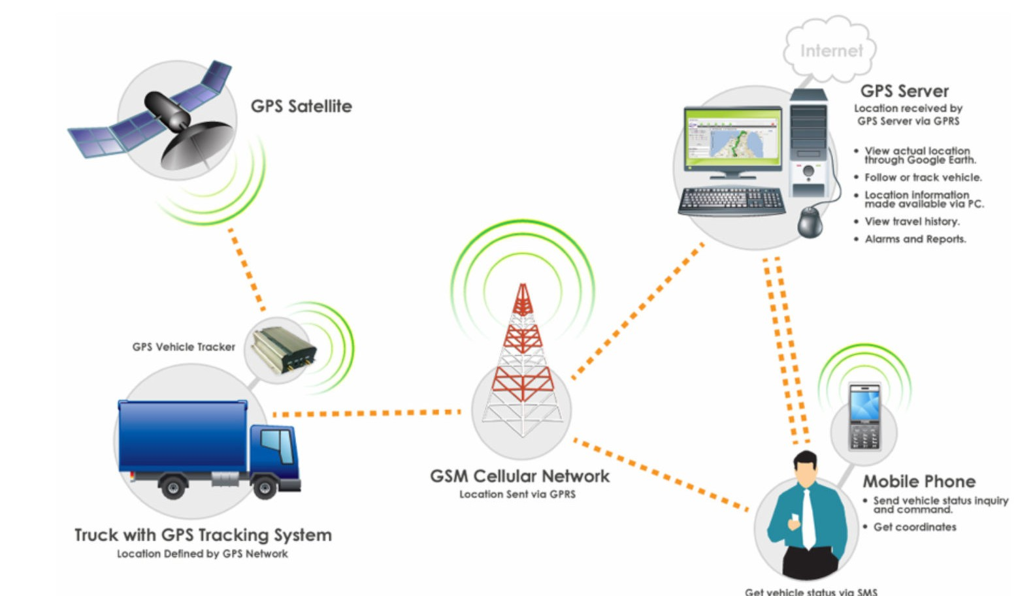
HARDWARE REQUIREMENT
GPS Devices: For real-time vehicle tracking.
Telematics Devices: To collect data from vehicles, including fuel consumption, speed, engine diagnostics, etc
.Mobile Devices/Tablets:For driver communication and management access.On-Board Cameras/Sensors: For monitoring driver behavior, vehicle surroundings, and safety.
Server Hardware: For central data processing and storage (if on-premises)
Network Infrastructure: Robust internet connectivity for data transfer, preferably 4G or 5G for real-time updates.

Slide 4
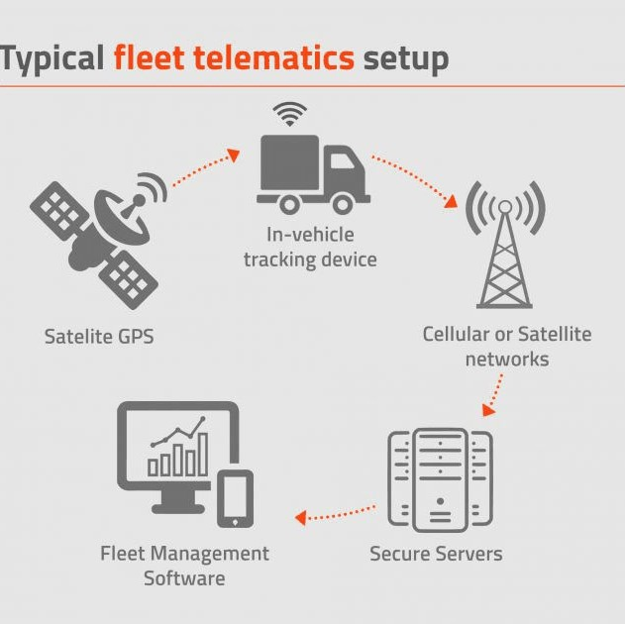
SOFTWARE REQURIMENT
Core platform that supports vehicle tracking, reporting, and data analytics (e.g., Geotab, Fleet Complete).
Mobile App: For drivers and ﬂeet managers to monitor performance, receive updates, and log events.Database Management System: For storing ﬂeet data (e.g., MySQL, PostgreSQL, or cloud-based solutions).API Integration:
To connect with third-party systems such as ERP, CRM, and management.

Slide 5
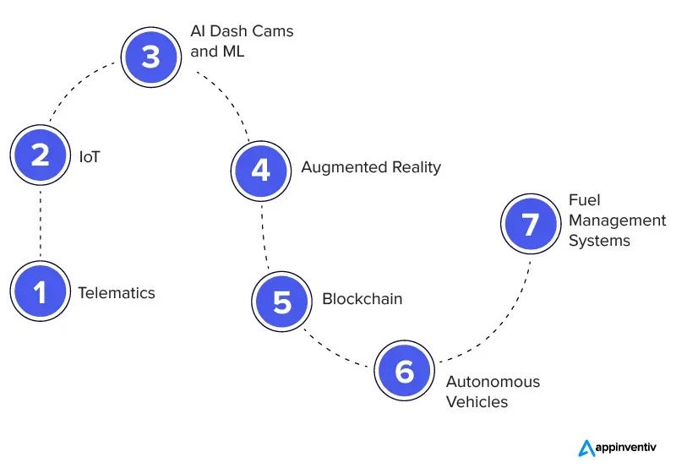
TECHNOLOGY USED
GPS & IoT Sensors: Collect real-time data for tracking vehicles, cargo, and driver behavior.
Cloud Computing: Data is stored and processed on the cloud for scalability and accessibility (e.g., AWS, Google Cloud).
Big Data Analytics: Analyzing vast amounts of data to identify patterns, improve decision-making, and predict maintenance needs.

Slide 6
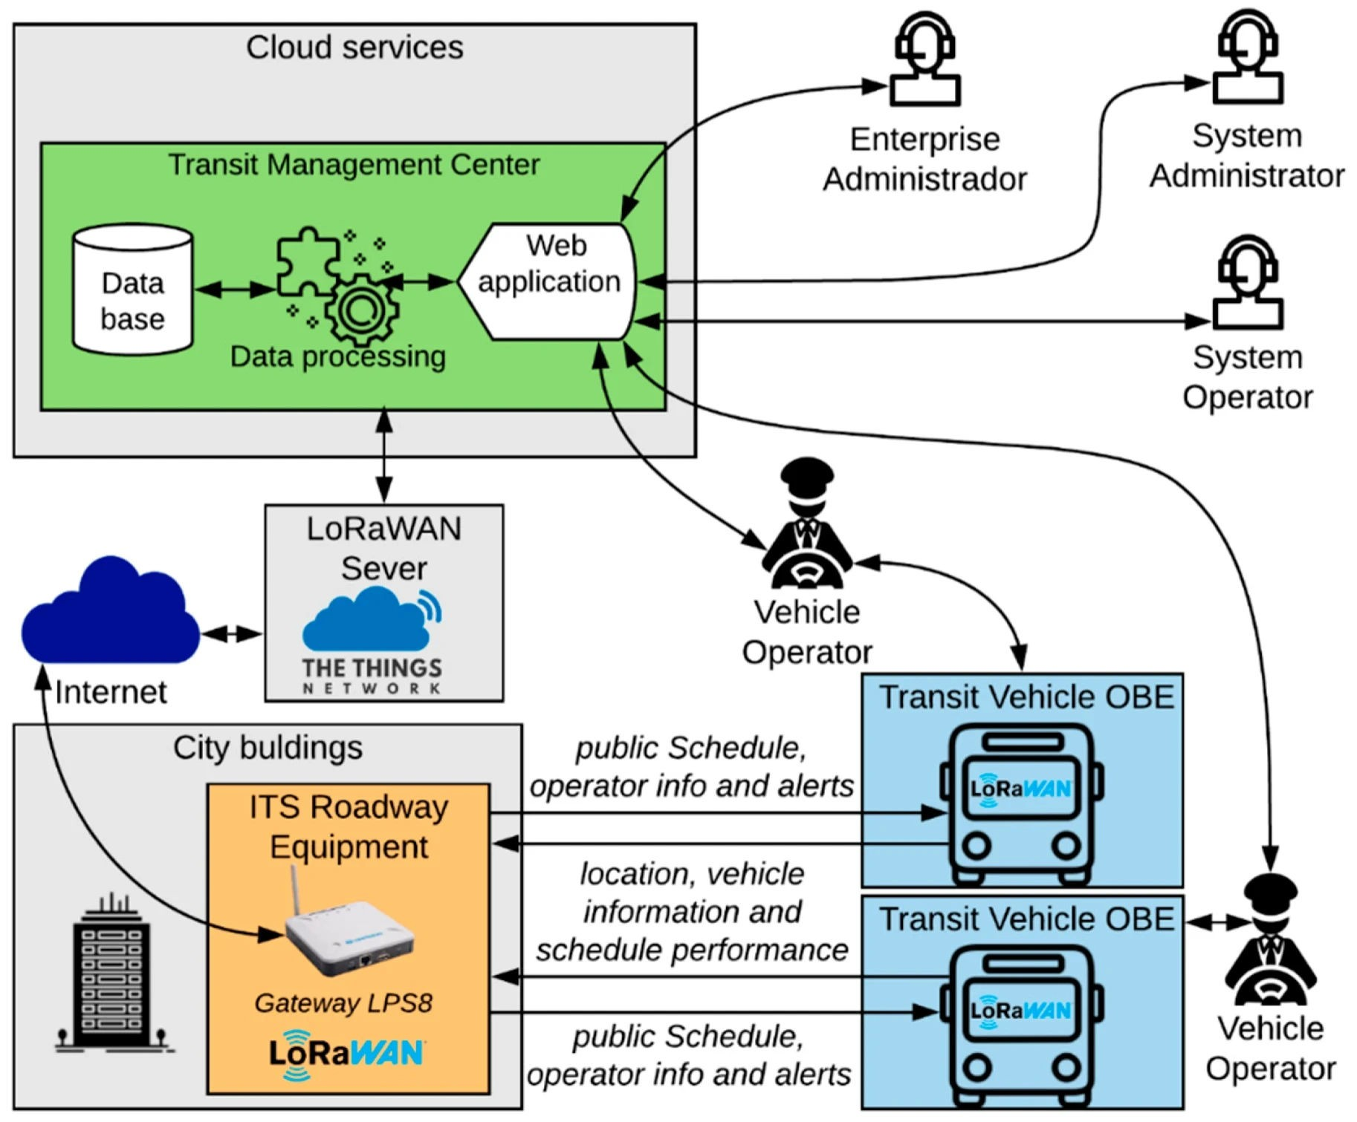
SYSTEM ARCHITECTURE DIAGRAM
Diagram Description: A diagram that shows the various components and their interactions. It could include:Vehicle (onboard devices): GPS, sensors, cameras, etc.
Mobile App: For drivers and ﬂeet managers to access the system. Cloud Server: Centralized data processing and storage.
Fleet Management Software: Interfaces with database and provides analytics.

Slide 7
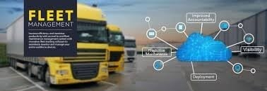
IMPLEMENTTION
Planning & Requirements GatheringUnderstand ﬂeet needs, data requirements, and integration points.Deﬁne KPIs for ﬂeet performance. System Design & CustomizationConﬁgure software, design user interfaces, and set up database structures.Customize features based on speciﬁc business needs.
Hardware InstallationInstall GPS devices, telematics, and sensors in all vehicles.
Provide training for ﬂeet managers and drivers on how to use the new system.
Go-Live & SupportDeploy the system for
daily use.Provide ongoing support, troubleshooting, and system updates.

Slide 8
Thanks
YOU

